Slide 1
DATABASE SYSTEMS • ASSIGNMENT 1 (OPTION 2)
Smart Household Water & Electricity Conservation System
Empowering UAE households to track consumption, receive high-usage alerts, and earn sustainability rewards.
Students
Student IDs
Strategic Goal
Omar Abou Hait & Shadi Habashi
202311455 • 202611112
UAE National Agenda: Sustainable Environment

Slide 2
PROJECT SCOPE • PHASE 1
System Purpose & Value Proposition
Automated Metering
Usage Anomaly Alerts
Conservation Incentives
Smart meters transmit synchronized monthly readings for water and electricity automatically without manual intervention.
Instant notification when a household exceeds its pre-established monthly consumption target threshold.
Residents receive 1 reward point for every unit saved beneath targets, promoting UAE sustainability goals.

Slide 3



USER ACTORS & PERMISSIONS
Primary System Stakeholders
Household Resident
Utility Staff
System Admin
Consumer accessing personal metrics via mobile or web portal.
Operational team managing infrastructure and regulatory rates.
Technical administrative oversight ensuring service resilience.
• Track monthly usage and bills
• Register households and smart meters
• Manage user access control and roles
• View alerts and earned reward points
• Configure tariffs and monthly targets
• Maintain daily backups and disaster recovery

Slide 4
INTEGRITY RULES
Core Business Rules & Constraints
4. Threshold Alert Generation
1. Meter-Household Relationship
If consumption > monthly target, the system immediately generates an overage alert.
Each household has ≥1 smart meter; each meter strictly belongs to exactly one household.
5. Mutual Exclusion: Reward vs. Alert
2. Single-Utility Meter Rule
1 reward point earned per unit below target; a reading triggers an alert OR a reward, never both.
Every meter records one designated utility type only (Water OR Electricity).
3. Non-Negative Monthly Read
6. Role-Governed Modifications
Exact 1 reading per meter/month; consumption values are constrained to ≥ 0.
Only utility staff hold permission to define and modify tariff rates and meter targets.

Slide 5
TECHNICAL ARCHITECTURE • PART 2
Database System Classification & Justifications
Aspect | Classification | Technical Justification
Data Model | Relational (RDBMS) | Structured relational tables connected by primary and foreign key constraints.
Users | Multi-User Concurrent | Simultaneous resident dashboard views alongside utility staff tariff configurations.
Architecture | Client-Server (Centralized) | Single central database engine serving web apps, mobile apps, and smart meter feeds.
Storage & Processing | OLTP + Monthly Batch Jobs | 12 annual reads per meter with end-of-month batch routines for alerts and rewards.
Concurrency & Recovery | Daily Backups & WAL Logs | Transaction write-ahead logging prevents double-billing and restores state on crash.
Security | RBAC & Access Controls | Role-based filters ensure residents access only their own household telemetry.

Slide 6

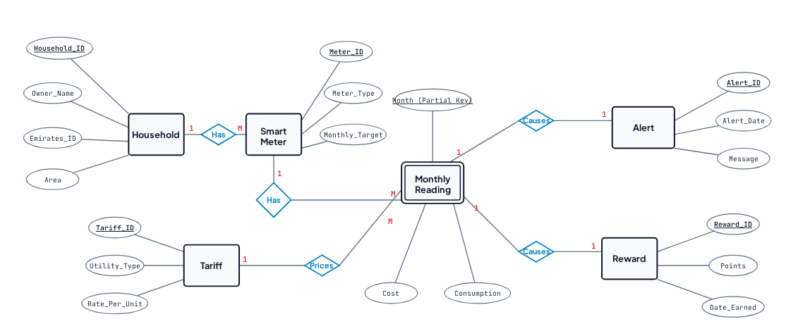
CONCEPTUAL DATA MODEL • PART 3
Complete Entity-Relationship (ER) Diagram

Slide 7
RELATIONAL MAPPING
ER Diagram Cardinalities & Foreign Keys
Entity 1 | Relationship | Entity 2 | Cardinality | Foreign Key Placement
Household | Has | Smart Meter | 1 : M | Smart_Meter holds FK (Household_ID)
Smart Meter | Has (Identifying) | Monthly Reading | 1 : M | Reading inherits Meter_ID in composite PK
Tariff | Prices | Monthly Reading | 1 : M | Monthly_Reading holds FK (Tariff_ID)
Monthly Reading | Causes (Above Target) | Alert | 1 : 1 | Alert holds FK (Reading_ID)
Monthly Reading | Causes (Below Target) | Reward | 1 : 1 | Reward holds FK (Reading_ID)

Slide 8
MODEL DECISIONS
Key ER Design Assumptions
01
02
03
Target on Meter
Mutual Exclusion
Historical Cost Invariance
The monthly target is stored directly on the smart meter, cleanly giving each household dedicated targets for water and electricity.
A reading either triggers an alert (when above target) or earns reward points (when below target), but never both.
Calculated cost is permanently stamped on the reading record so historic billing records remain unchanged when future tariffs change.

Slide 9
DATABASE SYSTEMS • SMART CONSERVATION SYSTEM
Thank You
Questions & Discussion
Omar Abou Hait (202311455) & Shadi Habashi (202611112)
UAE Sustainability Initiative

